Slide 1
Purpose
Observe Brownian motion of particles.
From observations of Brownian motion determine these fundamental constants:
    Avogadro’s number
    Boltzman’s constant

Slide 2
Brownian Motion
Atoms/molecules move “randomly” as they “collide” with
each other (they have kinetic energy).
Atoms/Molecules
Randomly moving atoms/
molecules randomly collide
with larger particles.
Larger particles also
perform a random motion.
Larger Particle

Slide 3

Displacement of a Particle
Displacement of one particle
during a given observation time t:
The movement is random,
so no one can predict
what exactly will be.

Slide 4
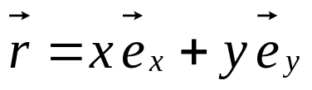

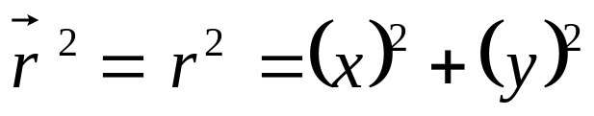
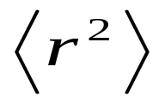
Mean Square Displacement
Suppose in two dimensions a displacement is
y
y
x
x
Then, squaring results in:
When such displacements are observed for many particles, one can
average these random values of r²
→ you get the “mean square displacement”

Slide 5
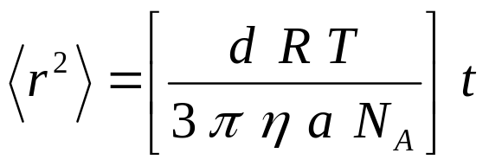
Einstein’s Theory
No individual particle movement can be predicted,
BUT: The mean square displacement can be predicted. This was done
by Albert Einstein using a theory of statistical mechanics developed
by Ludwig Boltzman. The result:
d: number of dimensions of movement
R: Universal gas constant
T: Temperature of the fluid in Kelvin
η: viscosity of the fluid
a: radius of the particle in the fluid
t: time of movement for each particle

Slide 6
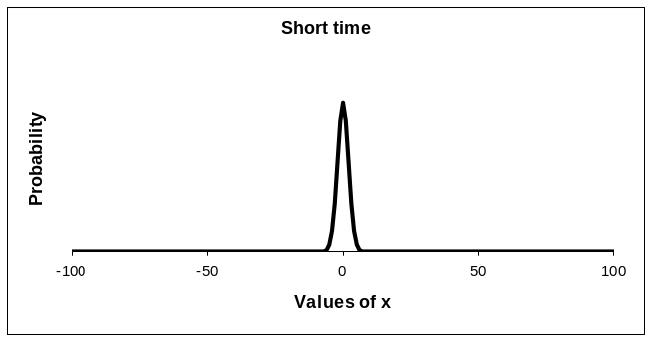
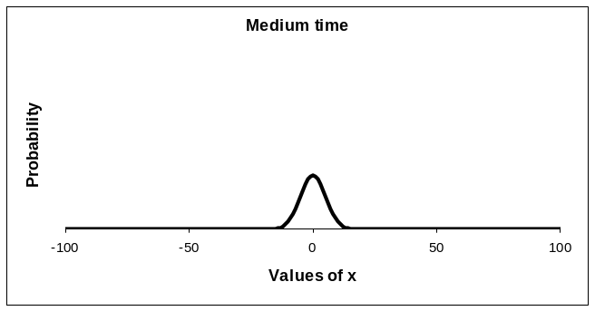
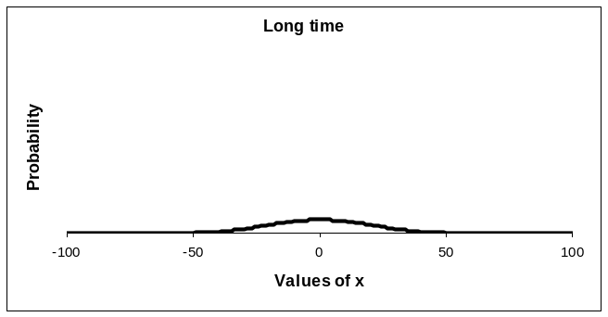
A Histogram of Displacements for Many Particles
For increasing time
it becomes more likely
to find particles
further away from
their starting point.
Increasing
time

Slide 7
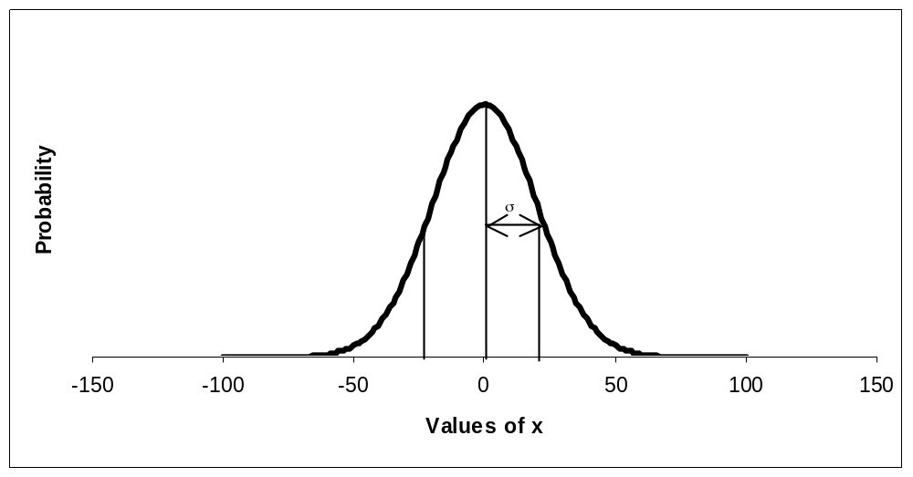
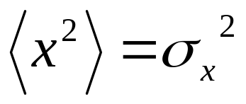
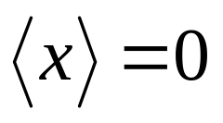
Relationship between <r²> and σ (Standard Deviation)
For a normal (Gaussian) distribution, in one dimension:
Note:
(average displacement = 0)

Slide 8
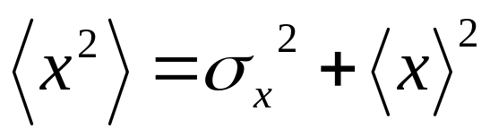
Flow Superimposed on Brownian Motion
Flow will shift entire curve off center → <x> is no longer 0

Slide 9
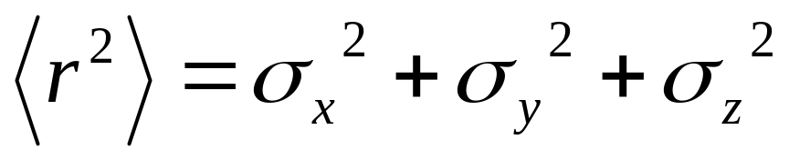
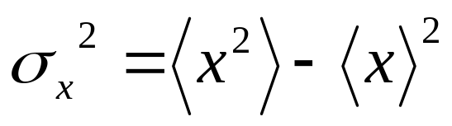
Einstein’s Formula considers only Brownian Motion, not Flow
From Brownian
Motion
From Flow
→ Use
(This means: You need to subtract the flow
effect from the mean square displacement.)
Etc.

Slide 10
Here’s the Basic Idea
We know: d, R, a (engineered particle sizes are known)
We can measure: T (and then get the temperature dependent
value of η from the graph in the manual)
We can also measure <r²> for a given time t - as we will see
We have everything from the above equation to calculate N_{A}
(Avogadro’s number).

Slide 11
The Tedious Part……Measuring <r²>
We do this by looking under a microscope at the movement of tiny spheres suspended in water.
(Note: We can only look at 2 dimensions of the motion
under the microscope, so d=2 in Einstein’s equation)
The microscopes have cameras inside.
→ Record movies of particle motion on the computer
using the “Applied Vision 3.0” software.
The recorded movies can be viewed and analyzed frame by frame using the “Tracker” software (each movie frame corresponds to a particular time t).
→ You can follow and record the path of individual
particles as time goes on.

Slide 12
Calibration
In “Tracker” you can measure the x and y coordinates of the
particles as time goes on (in terms of pixel numbers).
But: You need to know what the conversion factor is from pixel
numbers to an actual distance.
First look at a “Calibration Slide” under the microscope.
The calibration slide shows parallel lines that have a known
distance to each other. Follow instructions on getting the calibration
equation.
IMPORTANT:
The calibration slide must be inserted into the microscope
with the right side up. Otherwise you will not be able to focus.
2) Treat the calibration slide with great care. Put it back
into its protective plastic case as soon as you are done and return it to the shared table in the front of the room.

Slide 13
Calibration Slide
Ring makes it easier
to find the center
of the slide where
the tick marks are.
The small tick marks are separated by a distance of 0.01mm

Slide 14
Microscope Slide with Particle Suspensions
There is a pre-mixed liquid on the front table (containing a suspension of red particles).
Put one drop of the suspension (using a pipette) on a depression slide (microscope slide with a round depression in it to “pool” the liquid.
Cover the “pool” with one of the very thin glass cover slides. Try to avoid bubbles under the cover slide.
There is isopropyl alcohol and “Kim-wipes” available to clean the slides if necessary.

Slide 15
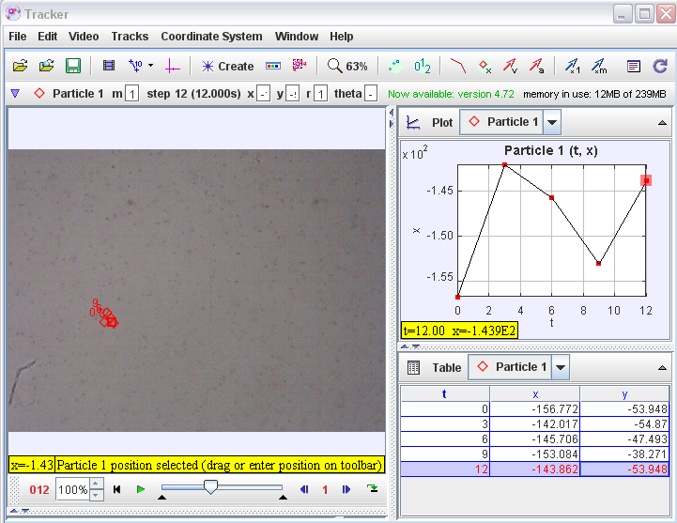
Tracker Software
X-Y table
To record a new position in the table use “Shift – left click mouse”
Advance frame by frame

Slide 16
Following Particle Motion in “Tracker”
You need to follow and record the same particle from frame to frame.
Use “Tracks” → “New” → “Point Mass” for each new particle you follow.
Follow lab manual instructions on how to configure the new track.
Only record the position every third second and exactly up to 33s.
Then pick another particle and repeat. You need 10 particles (no less).
Particles that disappear before 33 seconds can’t be used (they moved
out of focus on the microscope by “diving” down into the third
dimension).
Follow lab manual instructions on how to export the x-y data tables for each particle to Excel.

Slide 17
“By Hand” Evaluation for t=24 Seconds
time = 24s
Calculate by hand the
mean square displacement
of your 10 particles from
time t=0s to t=24s.
Solve for N_{A}

Slide 18
Use All Time Steps to Get N_{A}
<r²>
= slope of
<r²> versus t plot
t
It would be too tedious to repeat the <r²> calculation for each step
by hand.
Use our pre-configured spreadsheet where you only need to
fill in the x and y positions of each particle for each time.
(Lab Website: Click on “Hints/Links” and find the link to
“Brownian Motion – Excel Files” or find it under C:Physics Labs).

Slide 19
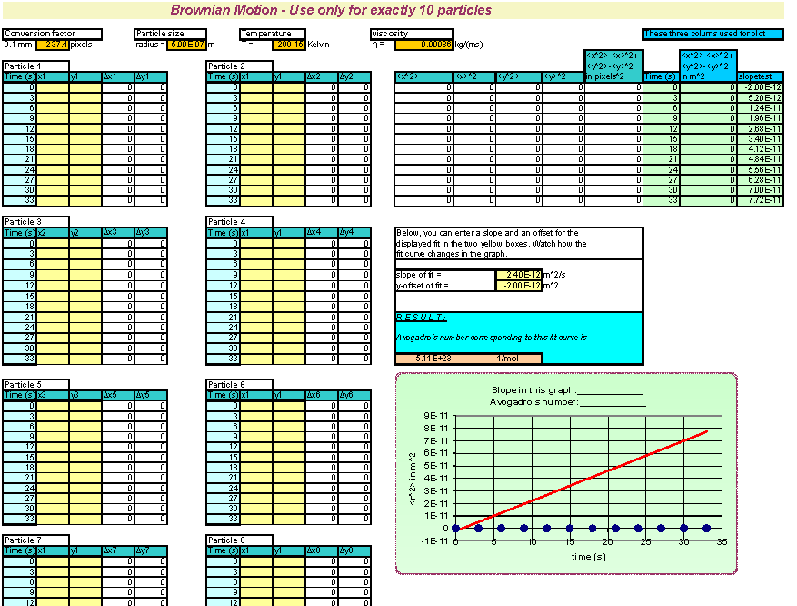
Fill in yellow
and orange fields
with positions
and other data like
temperature, particle
size, etc..

Slide 20
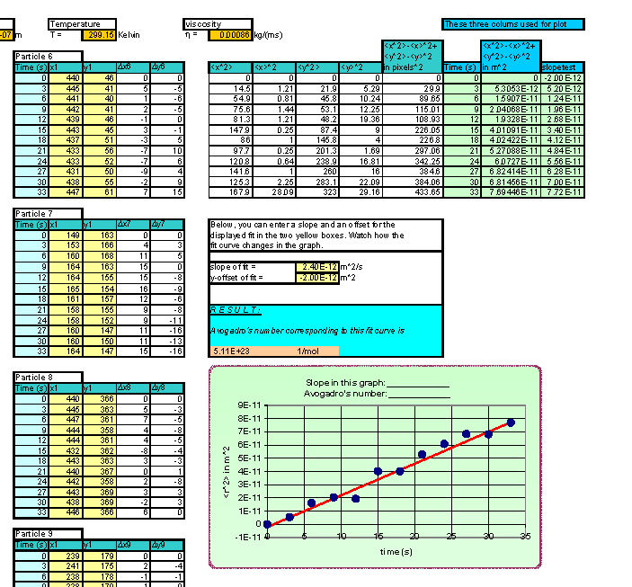
Results will be
calculated
…and displayed
in a graph

Slide 21
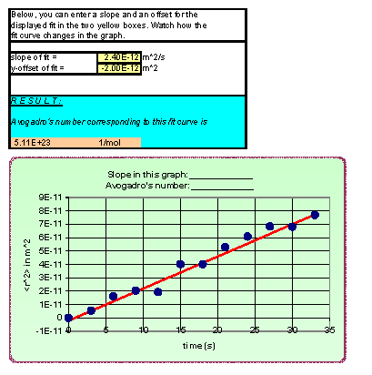
Change the
red “fit” curve
in the graph by
changing these
two values.
N_{A} corresponding
to the red fit line
is calculated in
the orange field.

Slide 22
Windows Virtual PC – XP Mode
Our Microscope camera has no driver for Windows 7. Therefore we need to run a virtual Windows XP environment.
Please follow the instructions in the lab manual on how to do that.
The following programs will run in the virtual environment:
  Applied Vision 3.0
  Tracker
Microsoft Office (for Excel Spreadsheet) will run only under Windows 7.
→ You need to move your data from the XP-environment to Windows 7 (instructions are in the lab manual on how to do that).

Slide 23
Please…..
…put calibration slides slides back into their protective plastic cover as soon as you are done with them.
…throw the very thin cover slides into the SHARPS CONTAINER once you are done.
…clean the depression slides with distilled water and KIM-wipes once you are done: They can be reused.
…throw any broken glass or other sharp items into the SHARPS CONTAINER, not in the regular trash.
THANK YOU!

